Slide 1


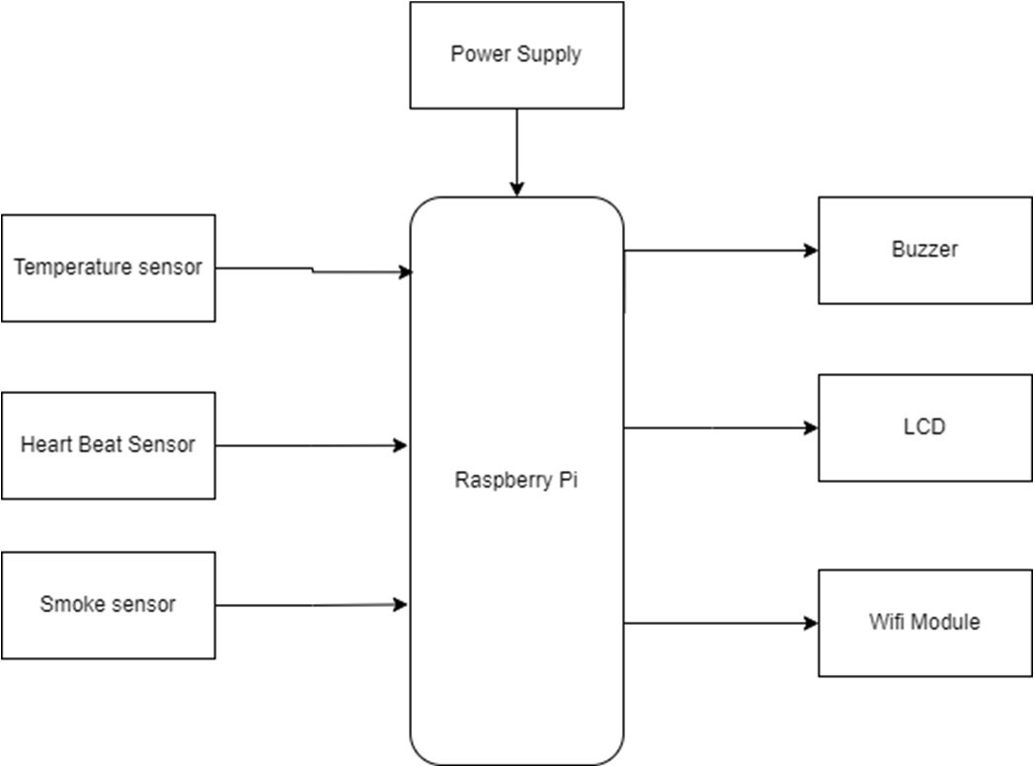
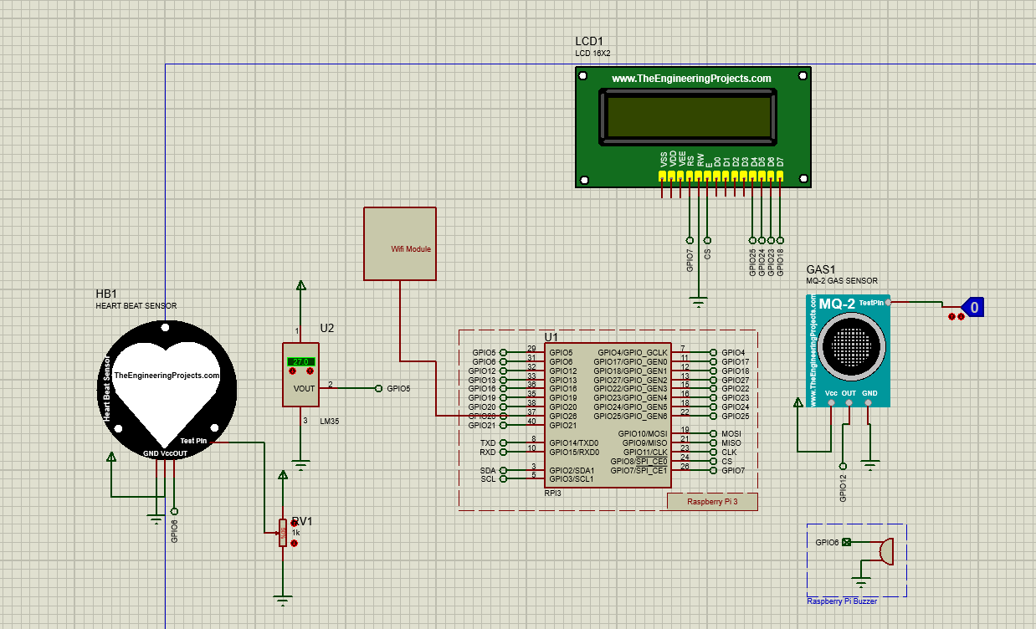
Pimpri Chinchwad Education Trust’s
Pimpri Chinchwad College of Engineering and Research, Ravet
Department of Electronics and Telecommunication Engineering
ADVANCED SAFETY HELMET FOR WORKERS
Introduction
Circuit Diagram
Aim and Objective
The mining industry has the highest incidence of occupational deaths among all industries. There are many case studies behind underground mines. To overcome all these disasters, we have developed a better communication technology which has to be employed for an intelligent sensing and warning system. Safety is the most vital part of any type of industry. The risks are increasing in case of coal industries.
The main aim of this project is to developed IOT Based working smart safety helmets
To avoid the conditions of environment changes.
To maintain security is a fundamental aspect of all.
To avoid accidents of workers working in mining industries.
Working Principle
Conclusion
The dangerous gases are sensed using gas sensors. Every time the poisonous gas is sensed the control valve gets opened for providing oxygen companion. In this project the raspberry pi is the major controller.System is able to monitor the health conditions of the worker as well as surrounding conditions. Also, if the worker health disturbed system will send the alert message. In the system temperature sensor, heartbeat sensor, smoke sensor , buzzer, WIFI module is used. Sensors will read the values and send it to the controller . If the conditions of environment changes like if smoke at the workers end increases system send alert.
A smart helmet for monitoring the surrounding environmental conditions and updating information and sensor data to the central console
References
Books/Papers: https://ieeexplore.ieee.org/document/9299586
https://doi.org/10.1053/jhin.2000.0854
https://www.ijert.org/research/iot-based-smart-helmet-for-ensuring-safety-in-industries-IJERTCONV6IS04068.pdf
Students Names: Mrunal Jadhav(25),Niraj Mistri (37),Akansha Pole (53)
Guide Name : Prof. Arti Tekade

